Slide 1

PANIMALAR ENGINEERING COLLEGE AN AUTONOMOUS INSTITUTION DEPARTMENT OF INFORMATION TECHNOLOGY
IT8611 Mini Project Project Review
III year/VI sem
AI TRESPASSER OVER BREACH MAIL
G.UGENDAR RAJ (211420205173)
SYAM SAI.K.G (211420205162)
S.YOGESHWARAN (211420205184)

Slide 2
Abstract
This paper presents a new AI trespasser system that uses breach mail technology to detect and prevent potential privacy violations by AI systems. The system operates by continuously monitoring AI systems for any signs of data breaches and sends out alerts to the relevant parties in the form of breach emails.
These breach emails contain detailed information about the nature of the breach, its severity, and any necessary actions that need to be taken to resolve the issue.

Slide 3
This system provides a proactive and effective solution to the problem of AI privacy breaches and will be valuable to organizations that rely on AI systems to manage sensitive information.
Here the Authorized Facial features of the existing members have been captured and trained using OpenCV, and the generated model dataset will be deployed to detect the unauthorized trespasser which in turn triggers a breach mail if the detected facial features are not found in the generated/trained dataset model.
This system is formulated to prevent from unauthorised invasion
in restricted areas.

Slide 4
Literature Survey
PAPER I TITLE: A novel DeepMaskNet model for face mask detection and masked facial recognition.
AUTHOR: Naeem Ullah , Ali Javed , Mustansar Ali Ghazanfar , Abdulmajeed Alsufyani , Sami Bourouis .
Method: Developed a largescale and diverse unified mask detection and masked facial recognition (MDMFR) dataset to measure the performance of both the face mask detection and masked facial recognition methods. Experimental results on multiple datasets including the cross-dataset setting show the superiority of our DeepMaskne framework over the contemporary models.
PAPER II TITLE: Masked Face Recognition for Secure Authentication
AUTHORS: Aqeel Anwar, Arijit Raychowdhury
Mehtod: We present an open-source tool, MaskTheFace to mask faces effectively creating a large dataset of masked faces. The dataset generated with this tool is then used towards training an effective facial recognition system with target accuracy for masked faces. We report an increase of 38% in the true positive rate for the Facenet system. We also test the accuracy of re-trained system on a custom real-world dataset MFR2 and report similar accuracy.

Slide 5
PAPER III TITLE: Masked Face Recognition using ResNet-50
AUTHORS: Bishwas Mandal, Adaeze Okeukwu, Yihong Theis
Method:this paper investigates the same problem by developing a deep learning based model capable of accurately identifying people with face-masks. In this paper, the authors train a ResNet-50 based architecture that performs well at recognizing masked faces. The outcome of this study could be seamlessly integrated into existing face recognition programs that are designed to detect faces for security verification purposes.
PAPER IV TITLE: Deep Facial Expression Recognition
AUTHORS: Shan Li; Weihong Deng
METHOD: In this survey, we provide a comprehensive review of deep FER, including datasets and algorithms that provide insights into these intrinsic problems. First, we introduce the available datasets that are widely used in the literature and provide accepted data selection and evaluation principles for these datasets. We then describe the standard pipeline of a deep FER system with the related background knowledge and suggestions for applicable implementations for each stage. For the state-of-the-art in deep FER, we introduce existing novel deep neural networks and related training strategies that are designed for FER based on both static images and dynamic image sequences

Slide 6
Existing System
Amazon Rekognition: Amazon Rekognition is a cloud-based facial recognition service that can recognize, identify, and verify faces in images and video footage. It can be used in various industries, such as security, retail, and entertainment.
Microsoft Azure Face: Microsoft Azure Face is a facial recognition API that can detect, analyze, and identify faces in images and video. It can be used for identity verification, access control, and customer engagement.

Slide 7
3.FaceFirst: FaceFirst is a facial recognition platform that can recognize faces in real-time and match them against a watchlist of known individuals. It is used in various industries, such as retail, transportation, and law enforcement.
4. Kairos: Kairos is a facial recognition API that can detect, verify, and analyze faces in images and video. It is used in various industries, including healthcare, finance, and security.
5. NEC NeoFace: NEC NeoFace is a facial recognition technology that can match faces against a large database of known individuals. It is used in various industries, such as law enforcement, border control, and aviation security.

Slide 8
Proposed System &its architecture
This paper presents a new AI trespasser system that uses breach mail technology to detect and prevent potential privacy violations by AI systems.
The system operates by continuously monitoring AI systems for any signs of data breaches and sends out alerts to the relevant parties in the form of breach emails.
These breach emails contain detailed information about the nature of the breach, its severity, and any necessary actions that need to be taken to resolve the issue.

Slide 9
Requirements of the Project
Hardware Requirement:
The Hardware requirements may serve as the basis for a contract for the implementation of the system and should therefore be a complete specification of the whole system. They are used by the software engineers as the starting point for the system design. It shows what the system does not and how it should be implemented.

Slide 10
Requirements of the Project
● 4 GB RAM (Minimum)
● 80 GB HDD
● Dual Core processor
● CDROM (installation only). VGA resolution monitors
● Microsoft Windows 98/2000/NT with service pack 6 / XP with service pack 2/ Windows 7 with service pack 2
● SQL Server 2008 R2

Slide 11
Software Requirements
The software specification are the specification of the system. It should include both the specification and a definition of the requirements. It is a set of what the system should do rather than how it should do it. The software requirements provide the basis for creating the software requirement specification. It is useful in estimating costs, planning team activities, performing tasks, and tracking the team’s progress throughout the development activity.
o DATASET: Image dataset.
o TOOLS: Visual Studio Code, Cmake.
o LIBRARIES: CNN, OpenCV, and Dlib.

Slide 12
Modules of the Project
The AI face recognition module typically consists of several sub-modules, including face detection, face alignment, feature extraction, and matching.
Face detection: This module identifies the location and size of faces in an image or video stream. It is often based on deep learning techniques that can accurately detect faces in various lighting conditions, orientations, and pose

Slide 13
Face alignment: This module corrects the orientation and position of detected faces to ensure that they are aligned in a standard format for further processing.
Feature extraction: This module extracts a set of unique features from each detected face, such as the distance between the eyes, the shape of the nose, and the contour of the jawline
Matching: This module compares the face template of a person to a database of known face templates to determine if there is a match.

Slide 14
Result discussion
In conclusion, our study has shown that Trespasser can be easily identified and take appropriate action over them. These results have important implications for the future development of AI technology.Overall, our research has contributed to the growing body of knowledge in the field of AI. By Triggering the mail, we have advanced our Exploration of the usage of AI for Unauthorized Trespassers.
This model can be enhanced better by using a High-end AI camera and using that in highly secured placed like Army and Defence force sector. Various kind of Airborne drones can be created from this model to deploy them into highly secured areas.

Slide 15
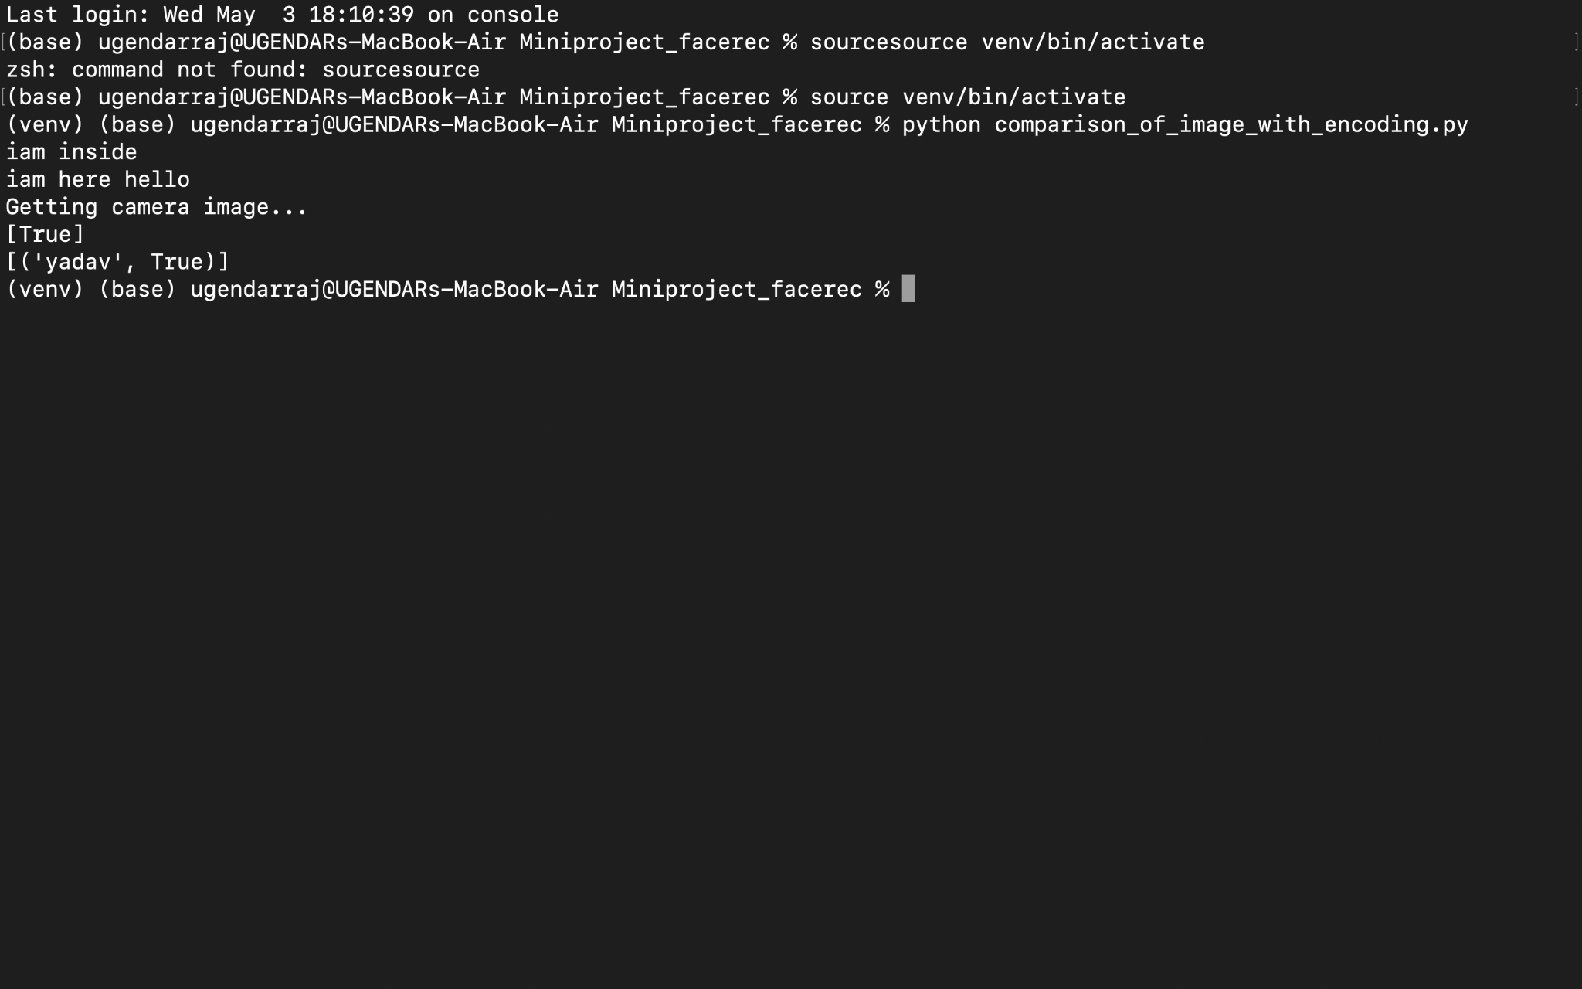
SCREENSHOTS

Slide 16
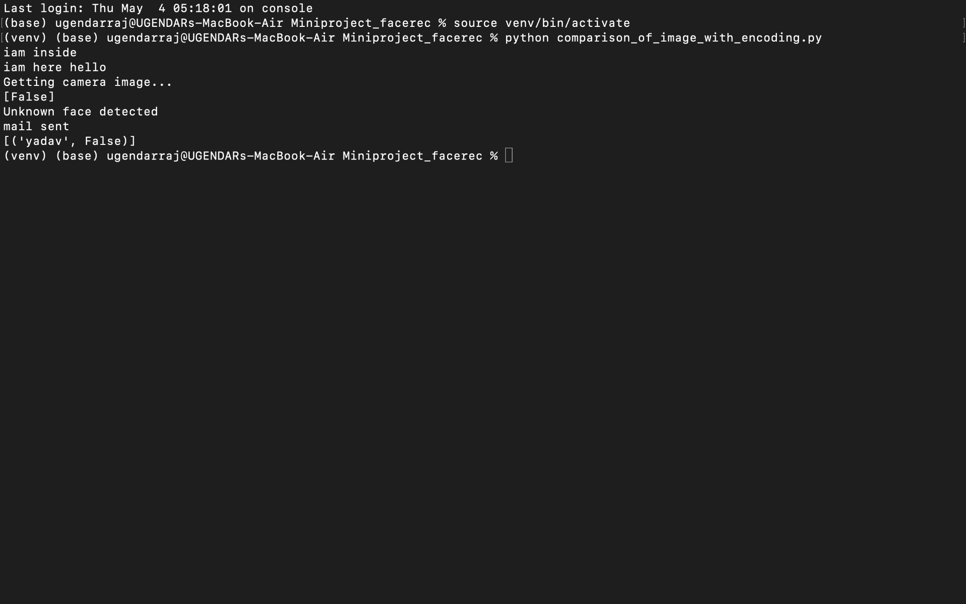
SCREENSHOTS

Slide 17
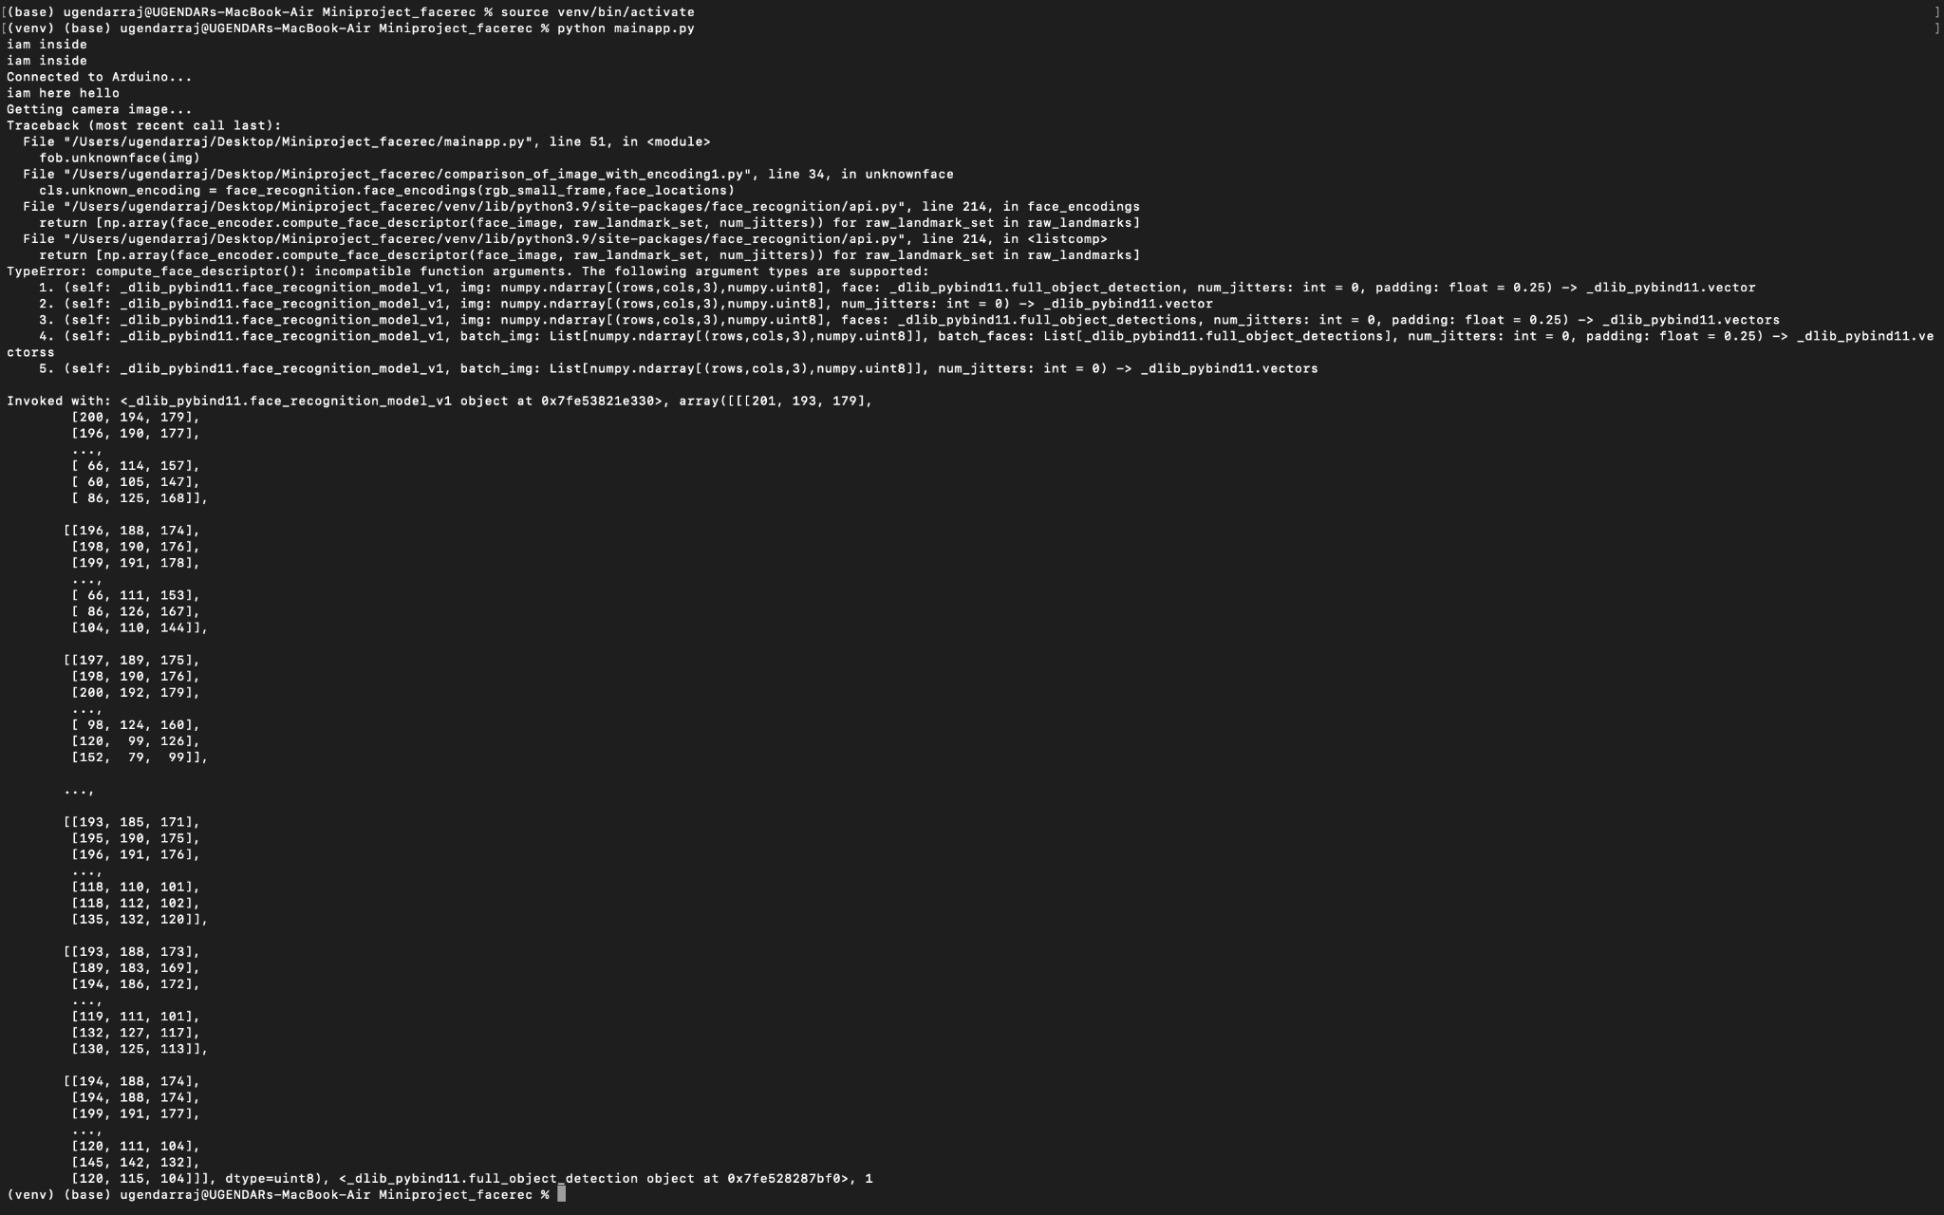
SCREENSHOTS

Slide 18
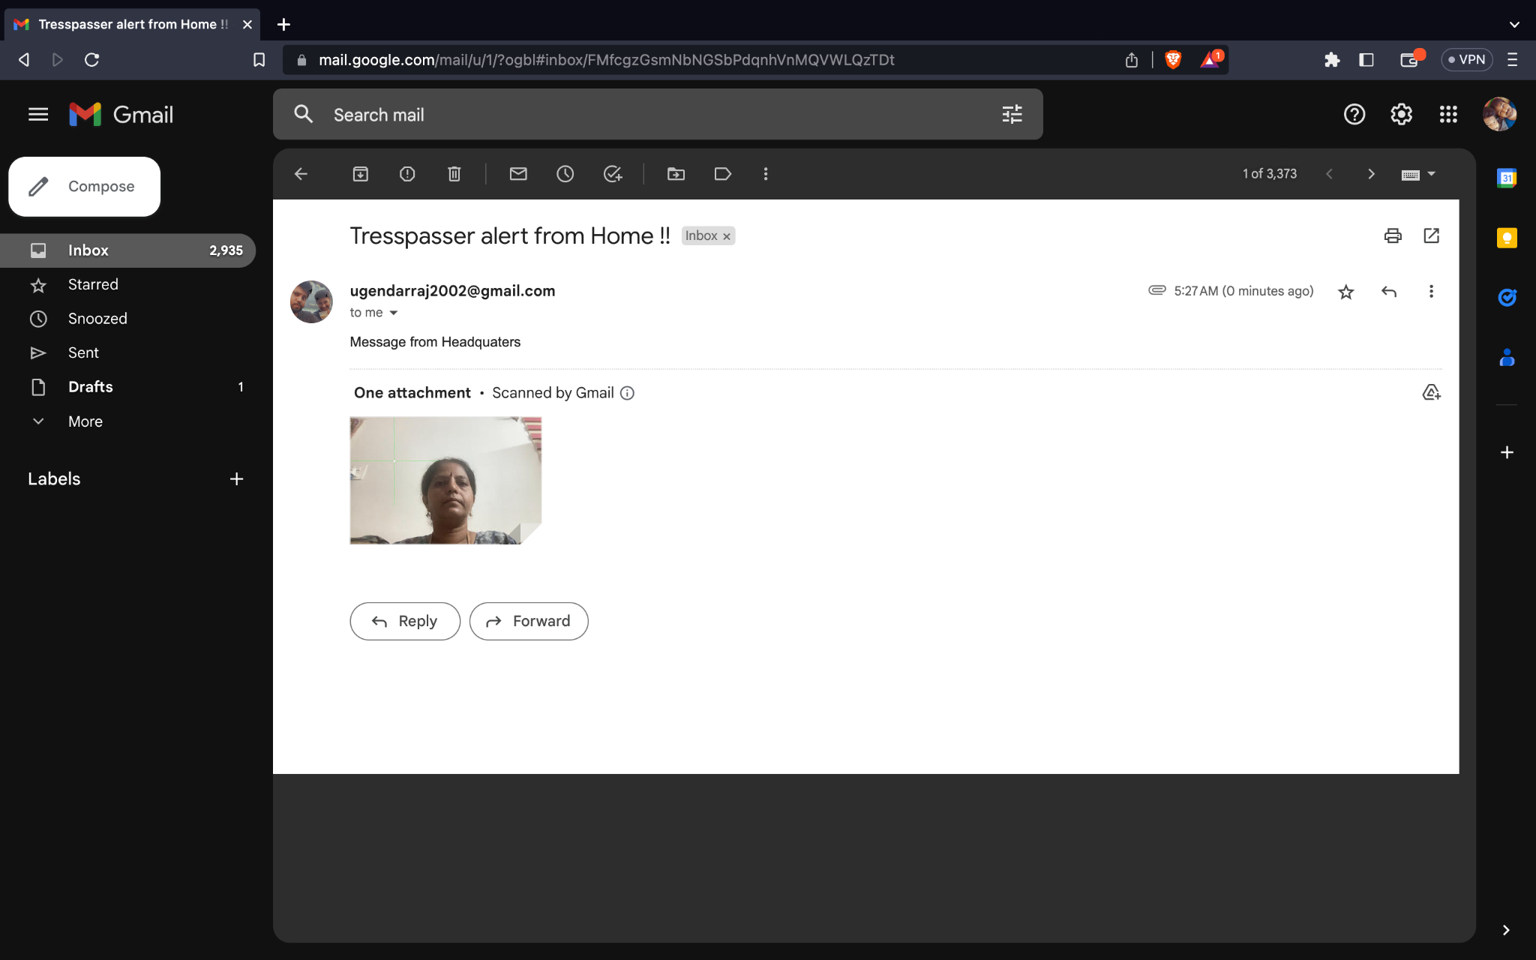
SCREENSHOTS

Slide 19
References
Ullah, Naeem, et al. ”A novel DeepMaskNet model for face mask detection and masked facial recognition.” Journal of King Saud University- Computer and Information Sciences (2022).
Anwar, Aqeel, and Arijit Raychowdhury. ”Masked face recognition for secure authentication.” arXiv preprint arXiv:2008.11104 (2020).
Mandal, Bishwas, Adaeze Nwokeukwu, and Yihong Theis. ”Masked face recognition using ResNet-50.” arXiv preprint arXiv:2104.08997 (2021).

Slide 20
Mundial, Imran Qayyum, et al. ”Towards facial recognition problem in COVID-19 pandemic.” 2020 4th International Conference on Electrical, Telecommunication and Computer Engineering (ELTICOM). IEEE, 2020.
Golwalkar, Rucha, and Ninad Mehendale. ”Masked-face recognition using deep metric learning and FaceMaskNet-21.” Applied Intelligence (2022): 1-12.
Wang, Zhongyuan, et al. ”Masked face recognition dataset and application.” arXiv preprint arXiv:2003.09093 (2020).
Dlib, https://github.com/davisking/dlib.
OpenCV, https://github.com/opencv/opencv .
C Qinghua. Analysis of face recognition technology based on deep learning [J]. Computer products and circulation, 2020(05): 136.

